Slide 1
BIKE SHARE ANALYSIS
NAME: N.NAGENDRA BABU
REG NO : 11805086
COURSE : INT217

Slide 2
Table of contents
INTRODUCTION
MOST POPULAR STATIONS
VIZUALIZATION OF DASHBOARD
CONCEPTS USED IN THE PROJECT
OBJECTIVES OF THE PROJECT
LEARNING OUTCOMES

Slide 3
introduction
Over the past decade, bicycle-sharing systems have been growing in number and popularity in cities across the world. Bicycle-sharing systems allow users to rent bicycles for short trips, typically 30 minutes or less. With the latest technologies, it is easy for a user of the system to access a dock within the system to unlock or return bicycles. These technologies also provide a wealth of data that can be used to explore how these bike-sharing systems are used.
In this project, we will perform an exploratory analysis on data provided by Motivate, a bike- share system provider for many major cities in the United States. We will compare the system usage between three large cities: New York City, Chicago, and Washington, DC. We will also see if there are any differences within each system for those users that are registered, regular users and those users that are short-term, casual users.

Slide 4
WHAT IS MEANT BY BIKE SHARE ANALYSIS?
A bicycle-sharing system, public bicycle system, or bike-share scheme, is a service in which bicycles are made available for shared use to individuals on a short term basis for a price or free. Many bike share systems allow people to borrow a bike from a "dock" and return it at another dock belonging to the same system. Docks are special bike racks that lock the bike, and only release it by computer control. The user enters payment information, and the computer unlocks a bike. The user returns the bike by placing it in the dock, which locks it in place. Other systems are dockless.. For many system.Smartphone mapping apps Show nearby available bikes and open docks.

Slide 5
MOST POPULAR STATIONS
Streeter Dr & Grand Ave
Lake Shore Dr & Monroe St
Lake Shore Dr & North Blvd
Theater on the Lake
Clinton St & Washington Blvd
Clinton St & Madison St
Michigan Ave & Oak St
Millennium Park
Canal St & Madison St
Canal St & Adams St

Slide 6
CONCEPTS USED
Pivot table
Hyper link
Data cleaning
Data harvesting
Data visualization
Graphs
Protecting worksheet
Conditional formatting

Slide 7
Objectives of the project
Most common hours
Most popular stations
Top and avg high duration
User and gender analysis
Common start week day

Slide 8
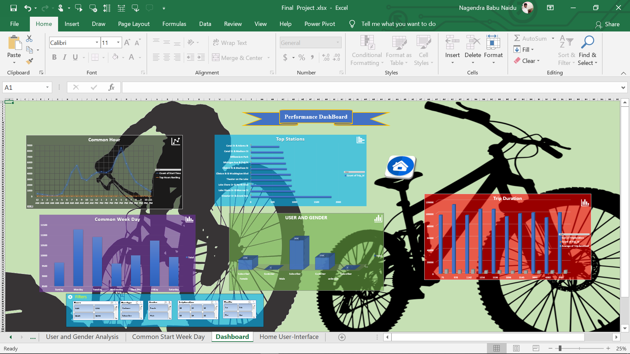
VIZUALIZATION OF DASHBOARD

Slide 9
LEARNING OUTCOMES
To good hand on excel.
To learn the etl process(using tableau prep)
How to link one sheet to another
How to use pivot table
Learn to make dashboard.
To make different type of graphs
To learn how to fetch data from other source to excel.
How to protect workbook
From this project we can know how to analyze the data

Slide 10
THANK YOU

